Slide 1
InsightFlow
Agentic AI-Powered Product Analytics Platform
Budget-Aware Adaptive Causal Investigation of Product Metric Anomalies
Manvi Chauhan · CSE22 · Advanced Software Engineering · IIT BHU
Real-Time Anomaly Detection
Adaptive AI Investigation
Natural Language Queries

Slide 2
The Problem
"Your retention rate just dropped 15%. Why?"
⏱
🔀
🧱
Hours of Manual Work
Multiple Root Causes
Fixed Investigation Pipelines
Analysts sift through dashboards, run queries, form hypotheses — taking days for answers that could be automated.
A single metric drop can stem from composition shifts, behavioral changes, data artifacts, or cohort effects — all look the same on a dashboard.
Existing tools run the same battery of tests regardless of what the data says — wasting compute and missing nuance.

Slide 3
InsightFlow — What It Does
📊
Live Metrics Dashboard
🔍
Statistical Anomaly Detection
Retention, activation, feature adoption, DAU, and acquisition funnel — computed in real-time from raw event data. Segmented by acquisition channel.
Kolmogorov-Smirnov two-sample test on rolling 7-day windows automatically fires an investigation when a metric shifts significantly.
🤖
Adaptive AI Investigation Engine
💬
Natural Language Query
Gemini-powered agent loop selects each next statistical test using greedy information-gain. Generates ranked, evidence-backed causal conclusions.
Ask questions in plain English — a Text-to-SQL agent translates to DB queries, returns the answer with the generated SQL shown.

Slide 4
System Architecture
React Frontend
FastAPI Backend
Gemini API
Recharts · 4 tabs
Python · SQLite WAL
gemini-1.5-flash-latest
Metrics Dashboard
Investigation Engine
Event Store
· Retention curve
· Hypothesis generation (Gemini)
· SQLite + WAL mode
· Acquisition channel breakdown
· Greedy info-gain test selector
· Events: signup, session_start,
· DAU + Activation funnel
· 6 statistical tests available
· feature_used, page_view
· Synthesis & recommendation (Gemini)
· 4 demo scenarios built-in
KS Anomaly Detector
NL Query Agent
· Rolling 7-day windows
· Text-to-SQL via Gemini
· KS two-sample test
· Schema-aware prompting
· p < 0.05 threshold
· Results + SQL shown

Slide 5
The Novel Contribution
Budget-Aware Adaptive Causal Investigation of Product Metric Anomalies
"First adaptive causal investigation framework for product behavioral metric anomalies, where a greedy information-gain selector dynamically chooses each next statistical test based on its discriminating power over unresolved hypotheses."
1
2
3
Product Behavioral Data
Adaptive Sequential Tests
Greedy Info-Gain Selector
User signups, sessions, feature usage — not infrastructure metrics, not process timing, not network logs
System picks each next test based on evidence already collected — not a fixed battery of tests run in order
Each candidate test scored by how many active hypotheses it discriminates; highest-scoring runs next

Slide 6
How the Investigation Engine Works
1
Anomaly Detected
2
Hypothesis Generation
3
Info-Gain Selection
KS test flags metric shift
(p < 0.05, |Δ| > 5%)
Gemini generates 5 candidate hypotheses with prior probabilities
Score each test by hypotheses it discriminates. Pick highest.
4
Run Statistical Test
5
Update & Decide
6
Synthesis
Execute DB query → compute p-value, effect size, breakdown
Update confidences. Loop until converged or budget spent.
Gemini writes plain-English conclusion + actionable recommendation
6 Statistical Tests Available: Kitagawa-Oaxaca Decomp. · Segment Share Drift · Funnel Drop Analysis · Feature Adoption Test · Cohort Age Test · Event Volume Test

Slide 7
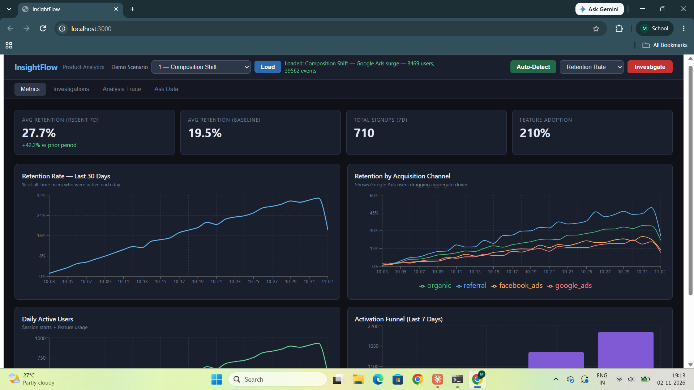
Demo: Metrics Dashboard
Scenario 1: Composition Shift
Google Ads surge floods with low-retention users. The aggregate metric hides the real quality drop.
Key Metrics Shown
27.7%
Avg Retention (recent 7d)
19.5%
Avg Retention (baseline)
710
Total Signups (7d)
210%
Feature Adoption

Slide 8
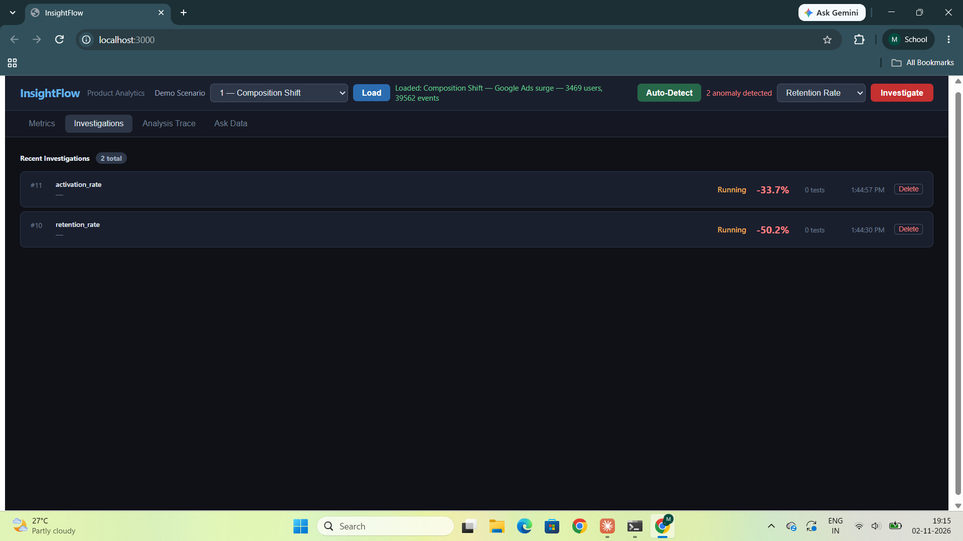
Demo: Automatic Anomaly Detection
Auto-Detect
One click runs KS tests across all three monitored metrics simultaneously.
retention_rate
-50.2%
Anomaly
activation_rate
-33.7%
Anomaly
Both investigations fire automatically in background threads — no manual trigger needed.

Slide 9
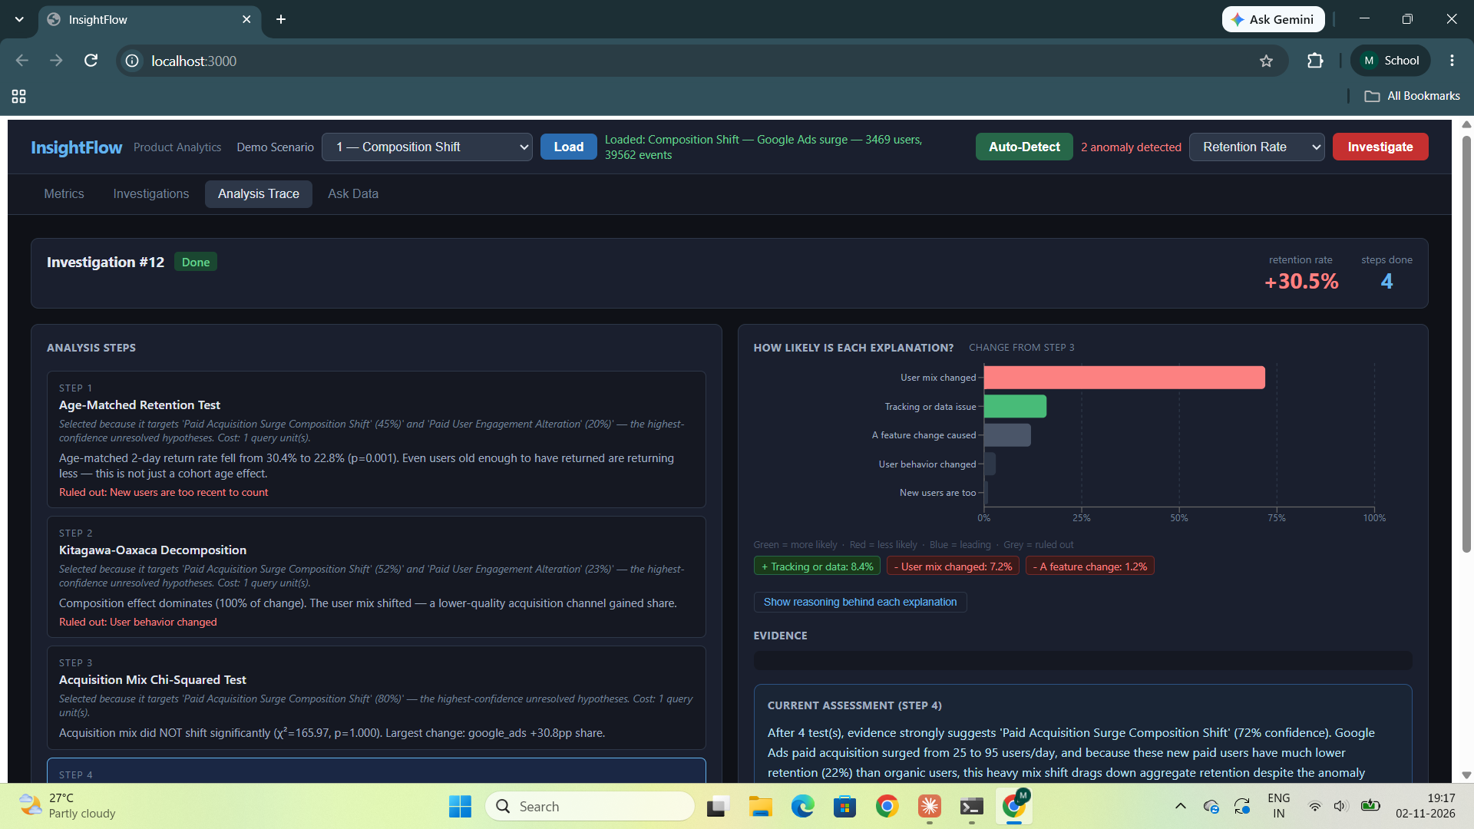
Demo: Adaptive Investigation in Action

Slide 10
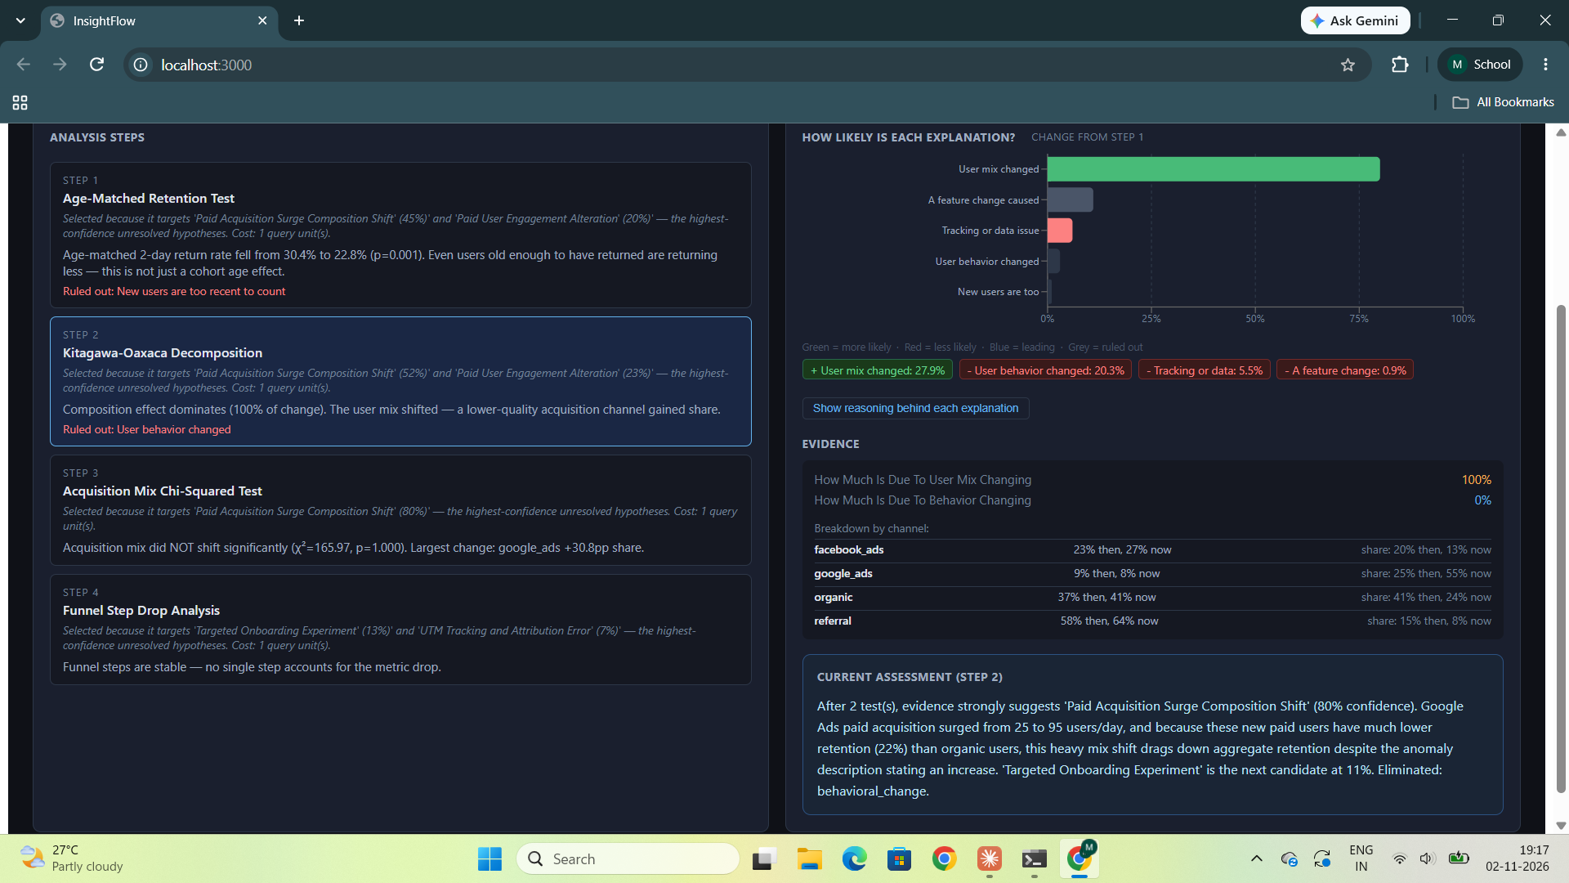
Demo: Kitagawa-Oaxaca Decomposition (Step 2)

Slide 11
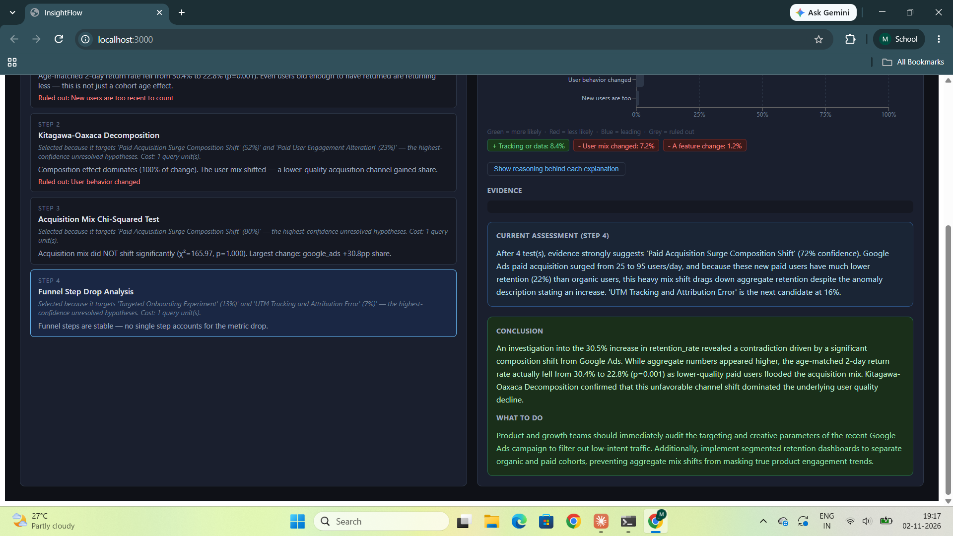
Demo: Conclusion & Recommendation

Slide 12
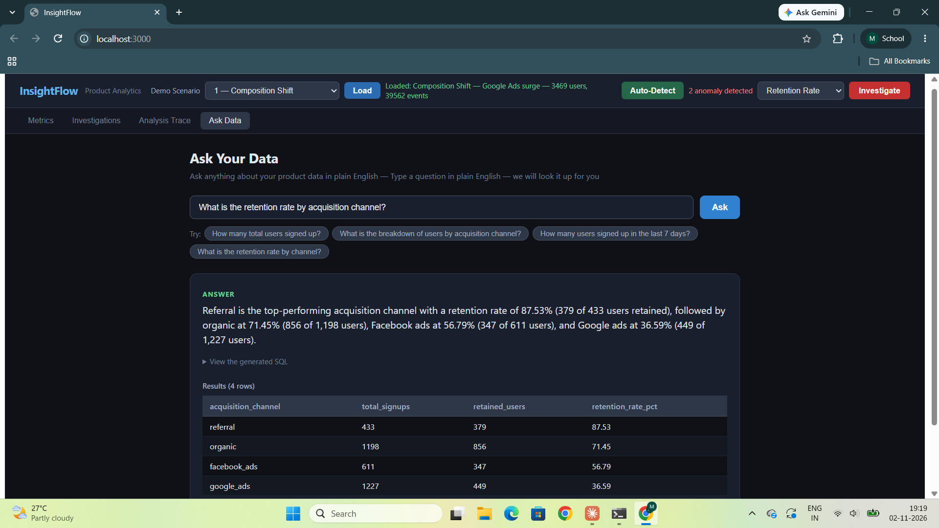
Demo: Natural Language Query

Slide 13
Related Work — Where We Stand
Paper
Domain
Pipeline
Our Advantage
RCLAgent (IEEE TDSC 2026)
Microservice traces
Topology-driven agents
Graph topology ≠ info-gain; no product data
Context-RCA (IEEE JCC 2026)
Microservices
Iterative consensus loop
Loop verifies agreement; ours selects next test
Process Anomalies (IEEE TSC 2026)
Business process logs
Fixed 3-step causal ML
Process timing, not behavioral product metrics
LLMDebug (AAIML 2026)
Microservice logs
Fixed multi-agent pipeline
Direct structural prior — ours adds adaptive selection
CHASE (IEEE TBD 2026)
Microservices (multimodal)
Fixed hypergraph fusion
Even multimodal systems use fixed pipelines
PatternMatcher (ISSRE 2021)
Infrastructure metrics
Fixed 3-step classification
No behavioral data, no adaptive test selection
No prior work applies adaptive sequential test selection to product behavioral event data — our formal novelty claim.

Slide 14
InsightFlow
Key Takeaways
✓
First adaptive causal investigation framework for product behavioral metric anomalies
✓
Greedy info-gain selector dynamically chooses the most discriminating statistical test at each step
✓
Covers 4 distinct root-cause types: composition shift, behavioral change, cohort age effect, data artifact
✓
Full working system: FastAPI + React + SQLite + Gemini, with live demo across 4 scenarios
Future Work: multi-metric correlation analysis · continuous background monitoring · Slack/email alert integration

